Slide 1

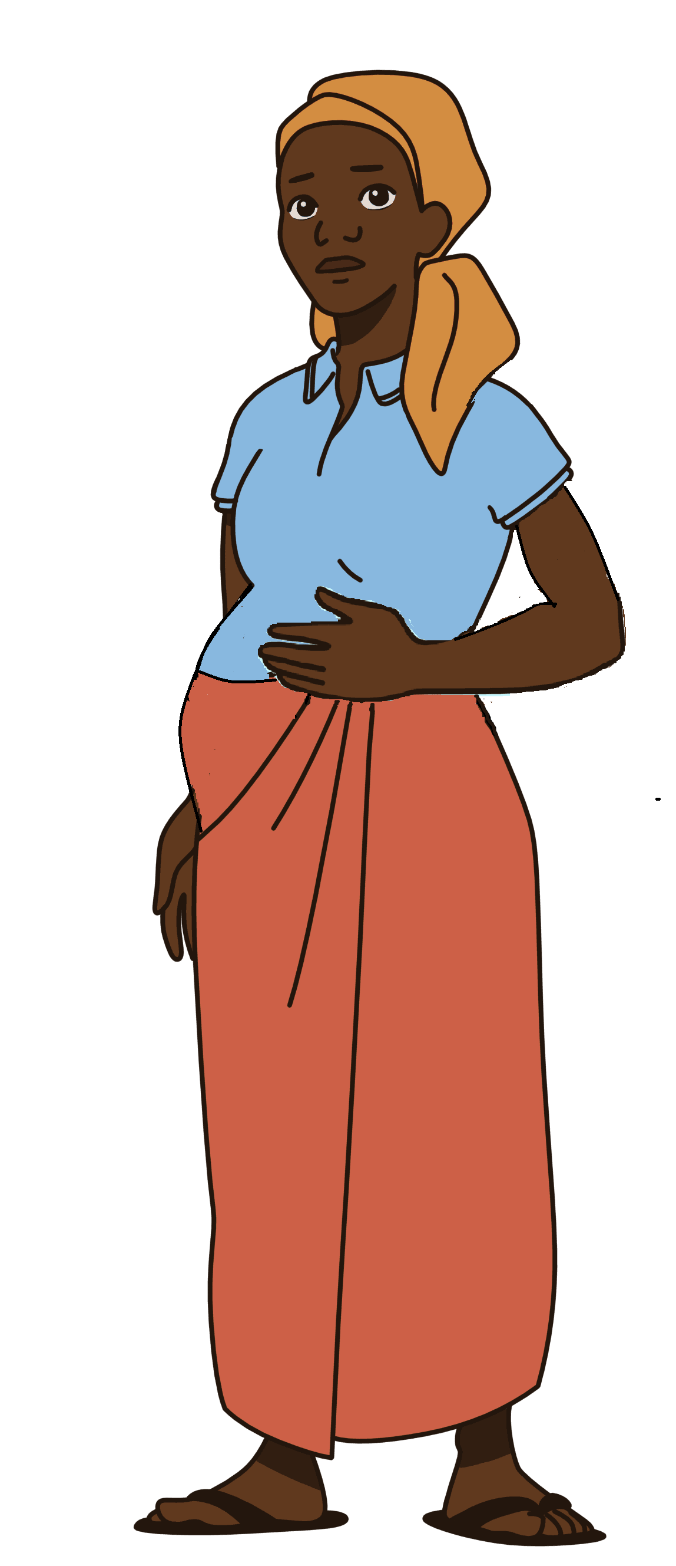
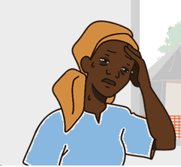
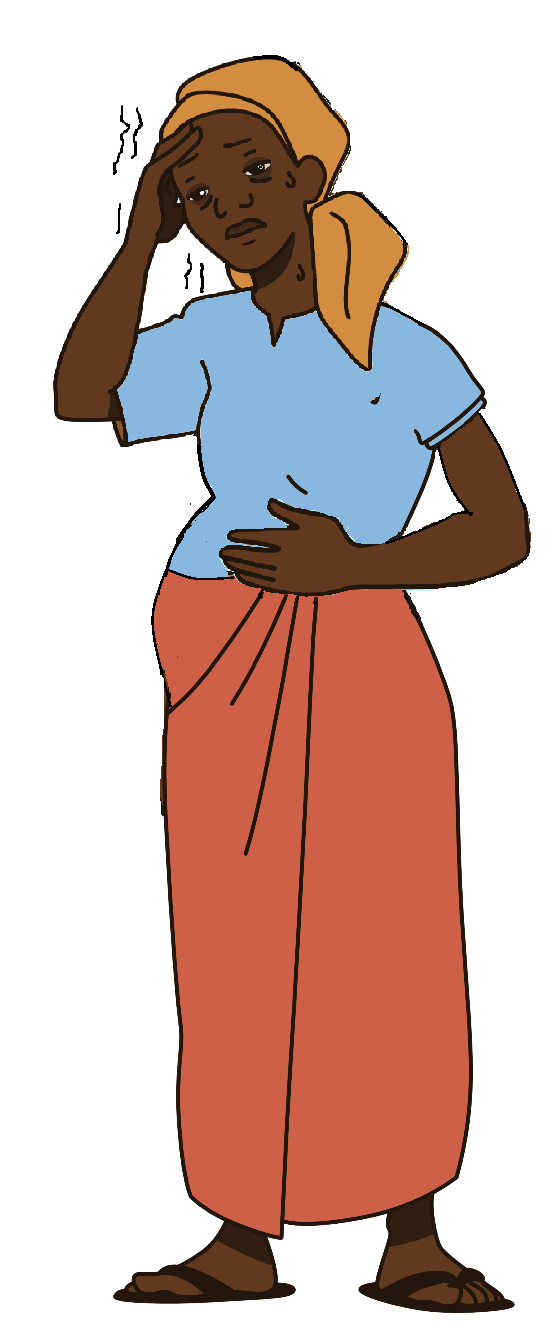
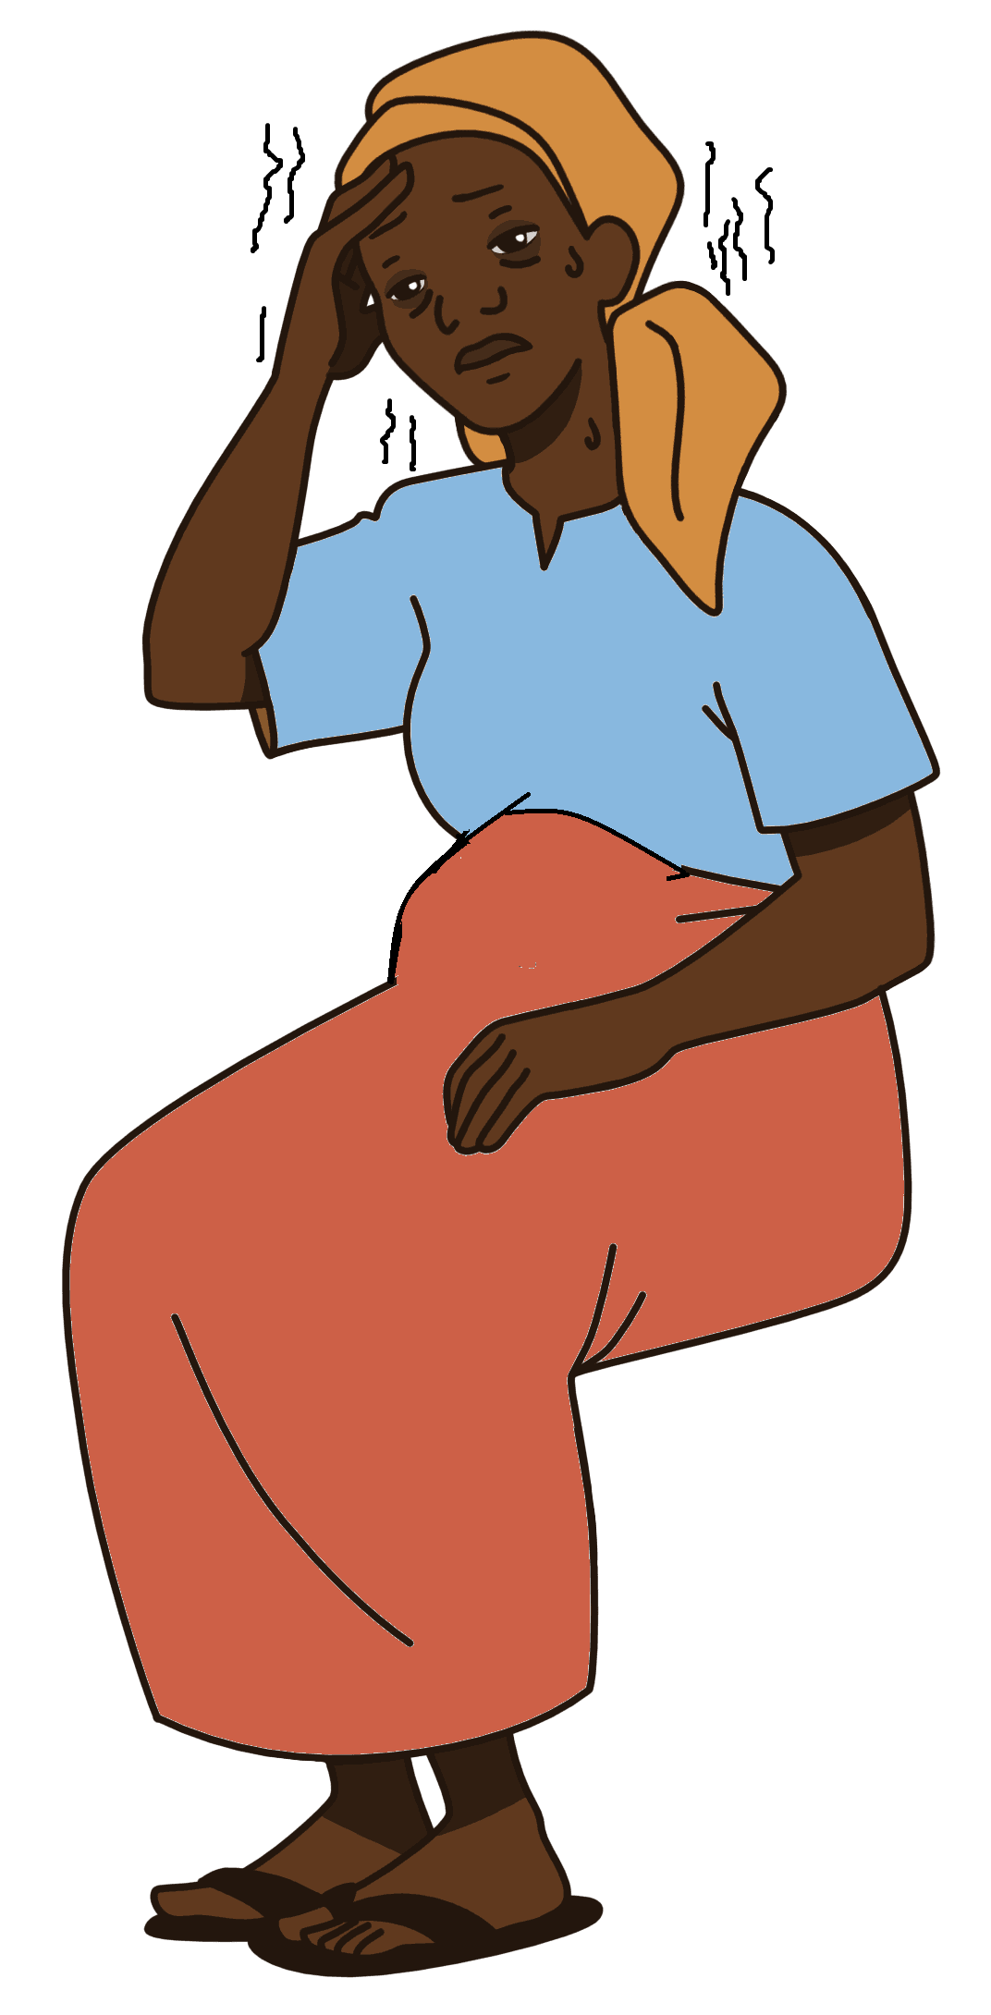


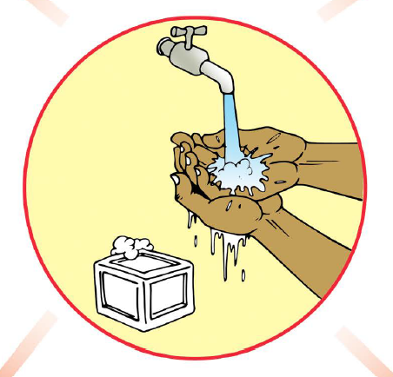
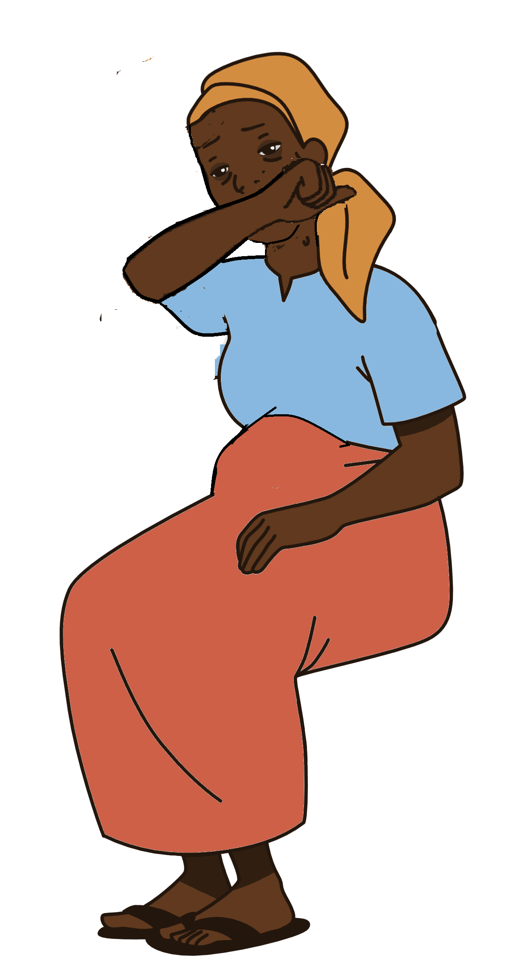
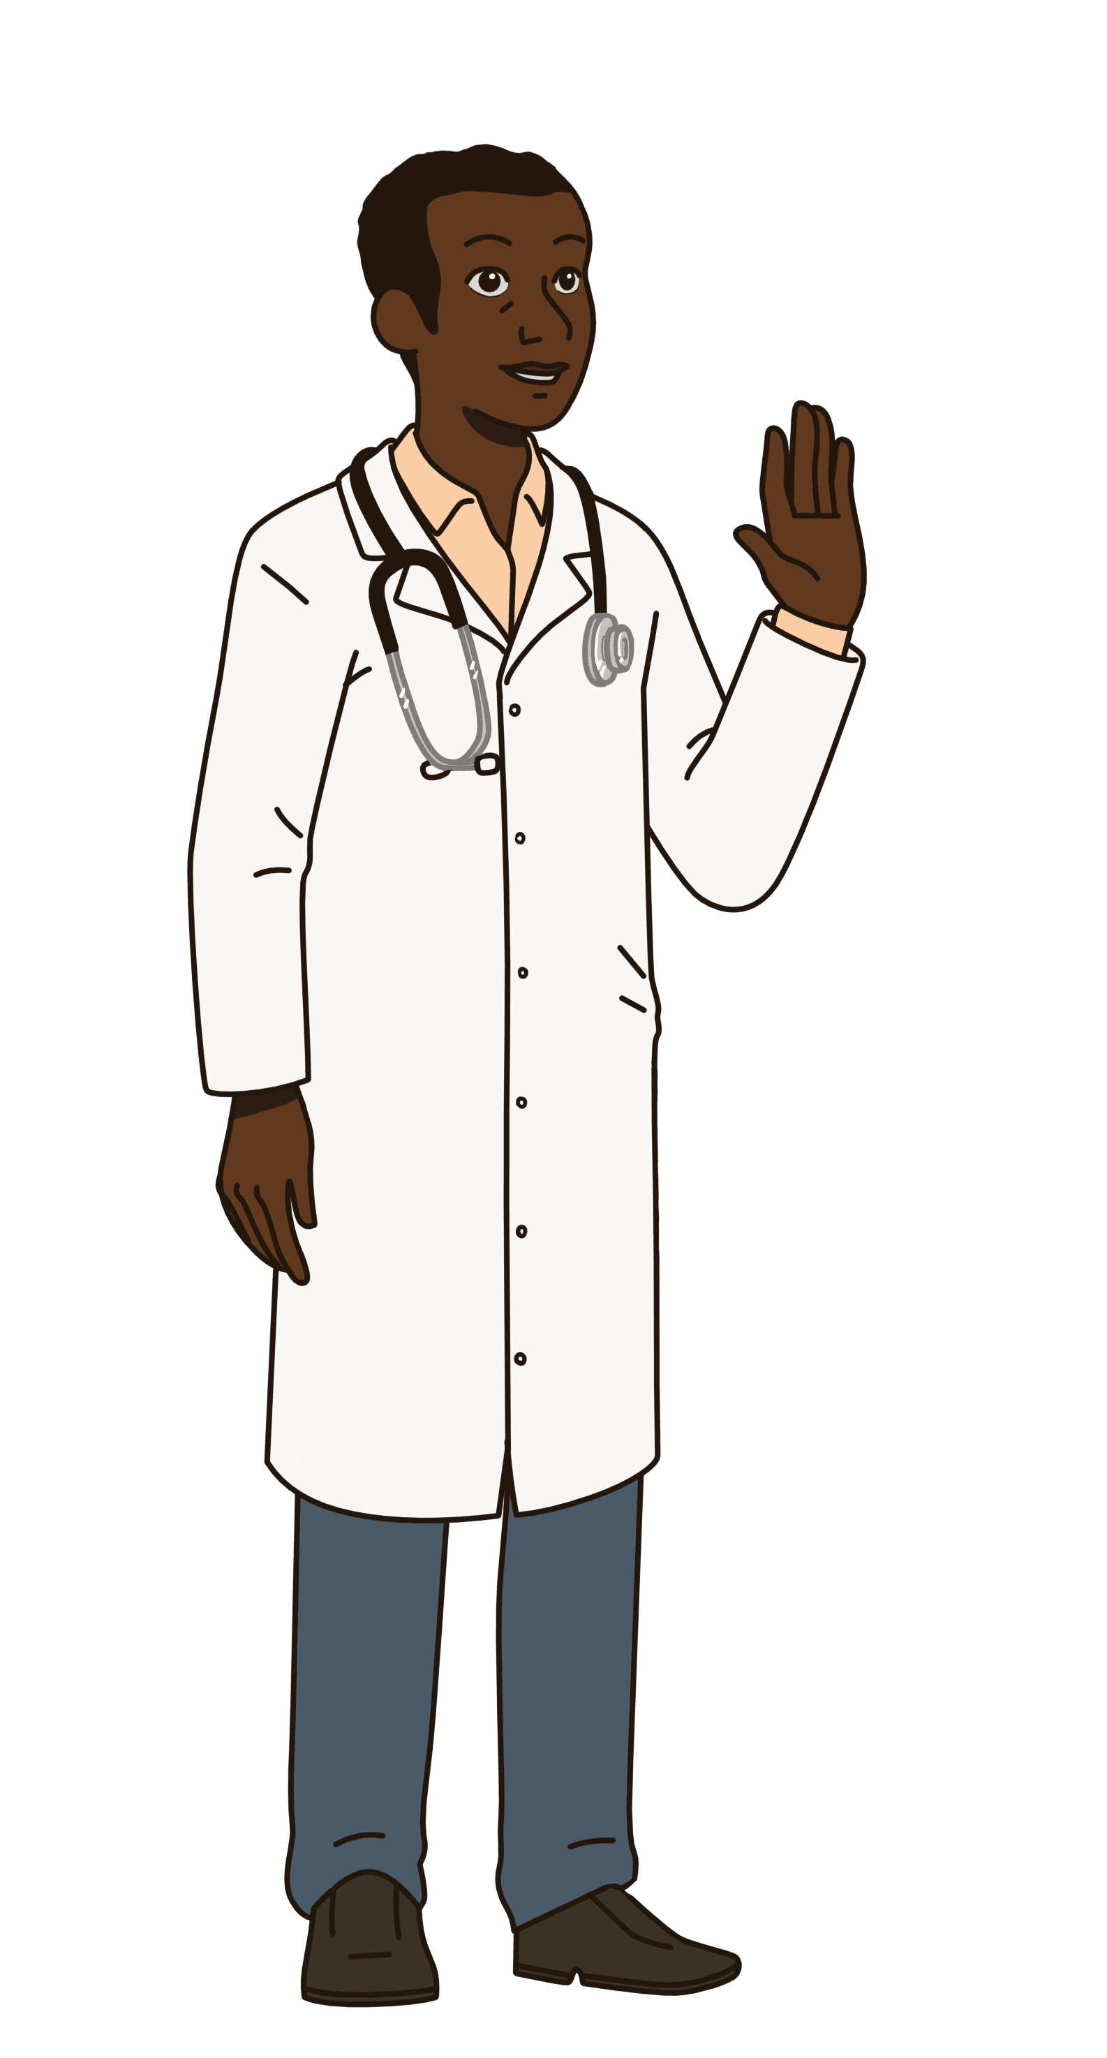


What should I do if I’m worried about my pregnancy or my baby ? Come to the health centre .
Specially if you have any of the following danger signs:
As a pregnant women, am I at higher risk for serious illness with COVID-19?
Changes in your body during pregnancy can make it easier for you to get sick with some respiratory illnesses. But so far, pregnant women with COVID-19 have not been getting worse symptoms than other people.
Severe Abdominal Pain
Fits
Headache
Fever
Information on COVID-19 for
Pregnant and Lactating Women
How can I protect myself against COVID-19?
Hand washing
Cover your
cough or sneeze
Leaking Fluid/water
Swollen legs
Vaginal Bleeding
What are possible symptoms of COVID-19?
If you have fever, cough or difficulty breathing, get medical care as soon as possible
Avoid touching
your face
Phone number /Adress/
4
1

Slide 2
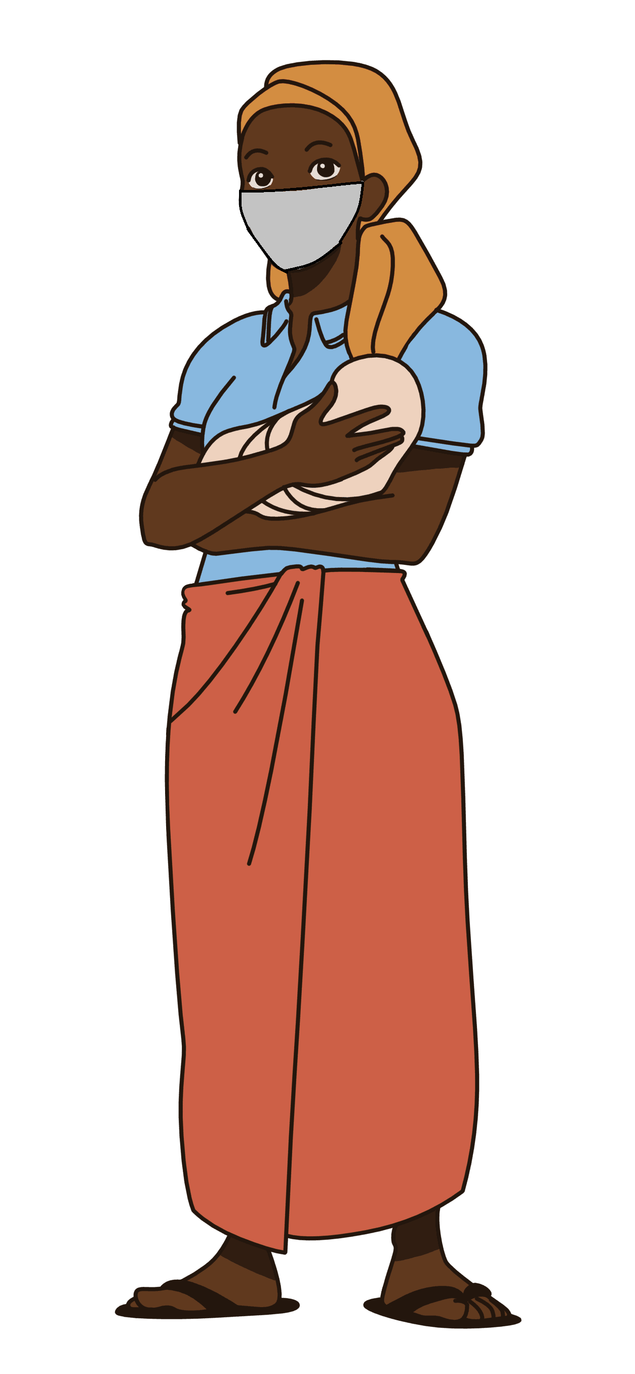
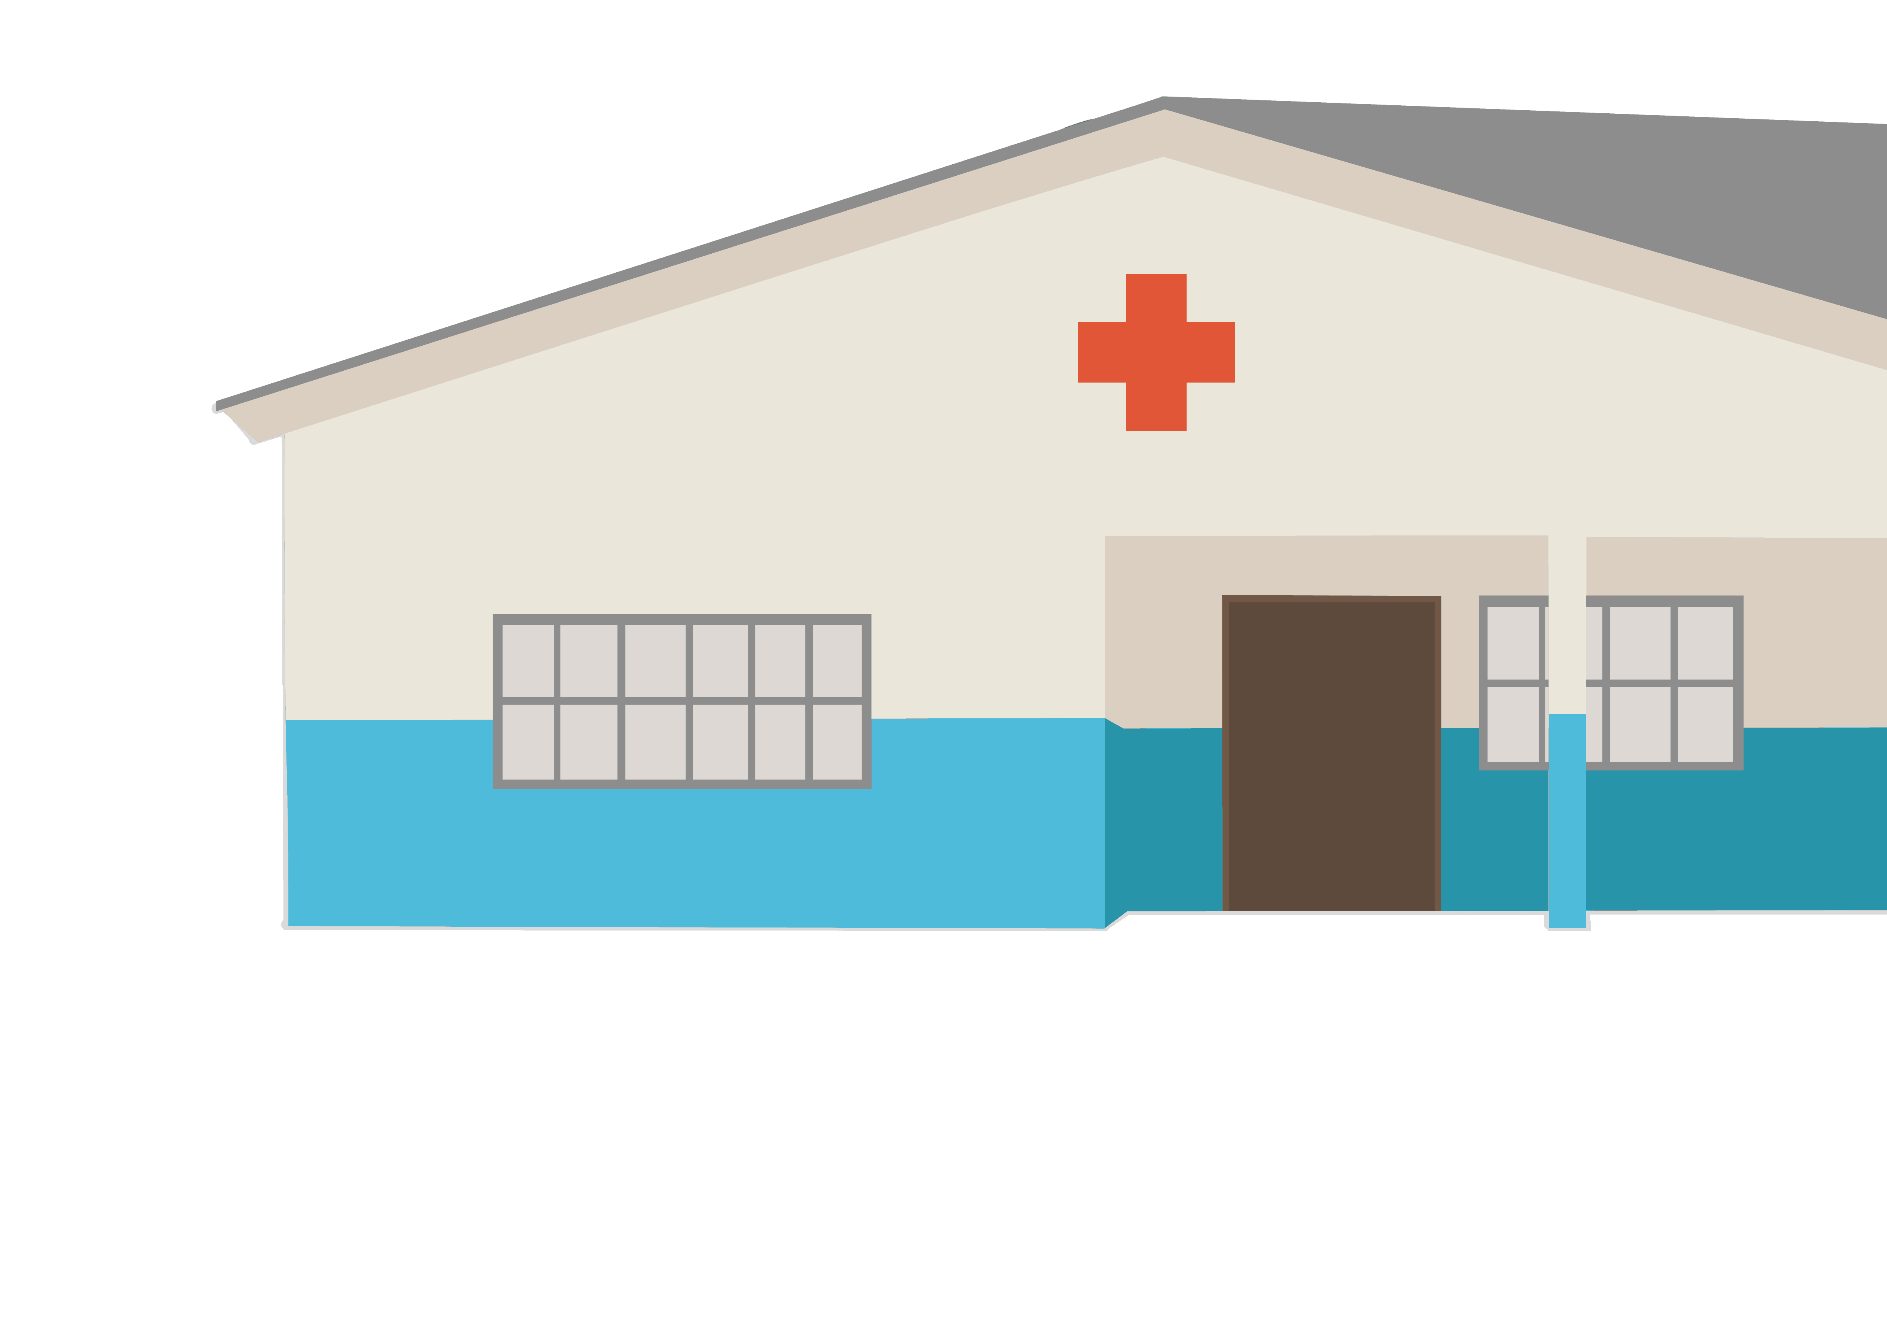
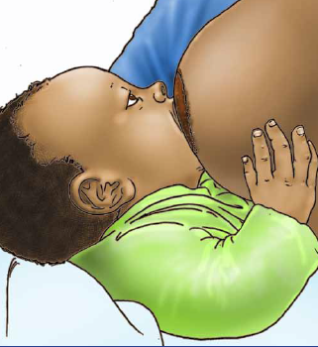
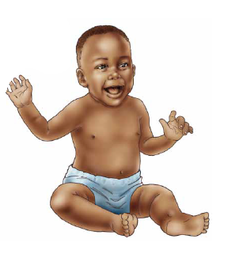
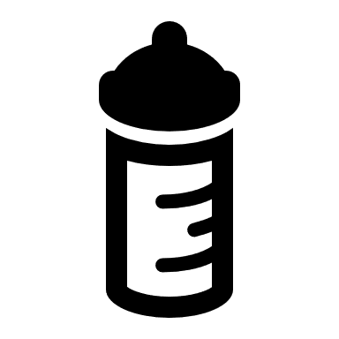
Should I continue to go the health center?
Can I touch and hold my newborn baby if I have COVID-19?
YES Keep your appointments and your midwife or doctor will tell you when to come if needed . The health centre will put safety measures in place to protect the patients and staff from getting COVID-19.
YES If you feel well enough to take care of your baby, he or she can stay with you in your room and you can have skin-to-skin (kangaroo mother care) contact.
To prevent this, wear a mask (where possible) and wash your hands before and after you are close to your baby
What about my delivery? Will I need a Caesarean Section if I have COVID-19?
Can I breastfeed my baby with COVID-19 ?
YES Continuation of breastfeeding is recommended with appropriate hygiene measures. To prevent passing COVID-19 to your baby through contact, wear a mask (if possible), wash your hands, and wash your breasts before nursing.
It remains important to go to the health facility to deliver or be sure to have a skilled birth attendant. COVID-19 is not an indication to have a C-section. It will depend on other factors related to your situation and will be assessed by your doctor.
What if I have COVID-19 and am not well enough to breastfeed my baby directly?
Can I pass COVID-19 to my baby?
Until now, research shows that COVID-19 has not been found in breastmilk, in amniotic fluid or in placentas tested after the delivery.
Newborn babies can get COVID-19 through contact with their mothers if the mother has the illness. To prevent this, wear a mask (where possible) and wash your hands before and after you are close to your baby
If you are not well enough to nurse your baby, we can help you to pump or express your milk and give it to the baby.
If you decide to not give breastmilk to your baby while you are sick, we will help you to give infant formula.
It is important to still pump your milk to keep up a good supply, so once you feel better, you can breastfeed your baby.
2
3

